Slide 1

Huawei HCCDA-AI certification
Trainer: Fawad Bahadur Marwat
2

Slide 2
High-level, interpreted, general-purpose programming language.
Known for its clear syntax, readability, and simplicity.
Programming Foundations
1 | Python Programming
2 | Virtual Environment
Data Handling and Visualization
1 | NumPy
2 | Pandas
3 | Matplotlib & Seaborn
4 | Dask
Mathesmatics for AI
1 | Linear Algebra
2 | Calculas
3 | Probability & Statistics
Machine Learning
1 | Scikit-Learn
2 | Model Evaluation
3 | Feature Engineering
Deep Learning
1 | Neural Network
2 | Framework
3 | Regularization Techniques
Computer Vision
1 | DIP
2 | CNN
3 | Advanced Topics
NLP
1 | Text Processing
2 | Language Models
3 | Transformers
Time Series and Sequence Modeling
1 | RRN
2 | LSTM
3 | Applications
Generative Models
1 | AutoEncoders
2 | VAEs
3 | GANs
Advanced Topics
1 | LLMs
2 | RF learning
3 | MLOps
Ethics and Responsible AI
1 | Bias and Fairness
2 | Pravicy
3 | Regulations
Capstone Project
1 | Project Development
2 | Presentation

Slide 3

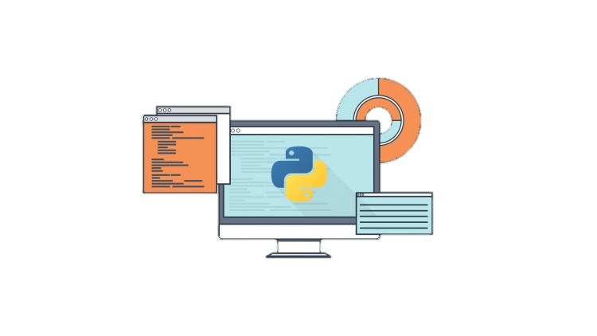

Introduction to Python
High-level, interpreted, general-purpose programming language.
Known for its clear syntax, readability, and simplicity.
What Is Python?
High-level, interpreted, general-purpose programming language.
Known for its clear syntax, readability, and simplicity.
Key Features
Easy to learn and write.
Versatile for web development, data analysis, automation, and more.
Large standard library and active community support.
Trainer: Fawad Bahadur Marwat

Slide 4
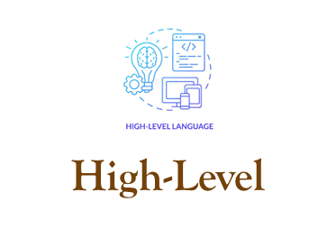
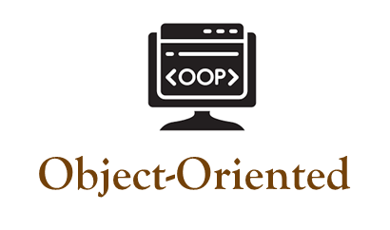
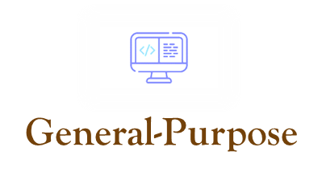
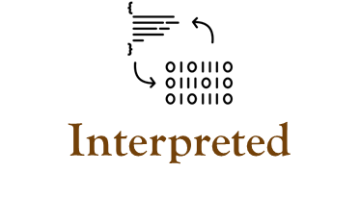
Key characteristics
Simple, abstracted coding
Classes, objects support
Versatile, multi-domain use
Runs without compilation
Trainer: Fawad Bahadur Marwat

Slide 5
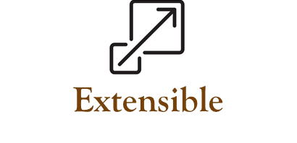

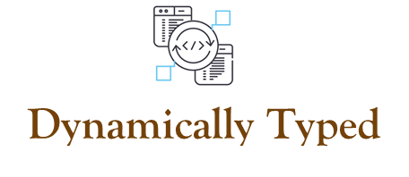
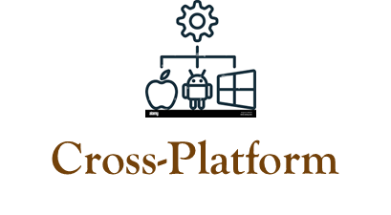

Conti…
Integrates external code
Rich libraries, tools
Flexible variable types
Runs on all OS
Active, supportive network
Trainer: Fawad Bahadur Marwat

Slide 6
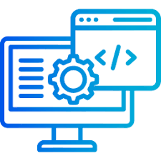


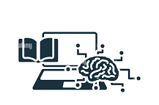


Python Programming
Applications
Web Development
Data Science
Data Analytics
Machine Learning & AI
Automation and Scripting
Software Development and Prototyping
Desktop GUI applications
Scientific and Numeric Computing
Game Development
Education and Research
Trainer: Fawad Bahadur Marwat

Slide 7
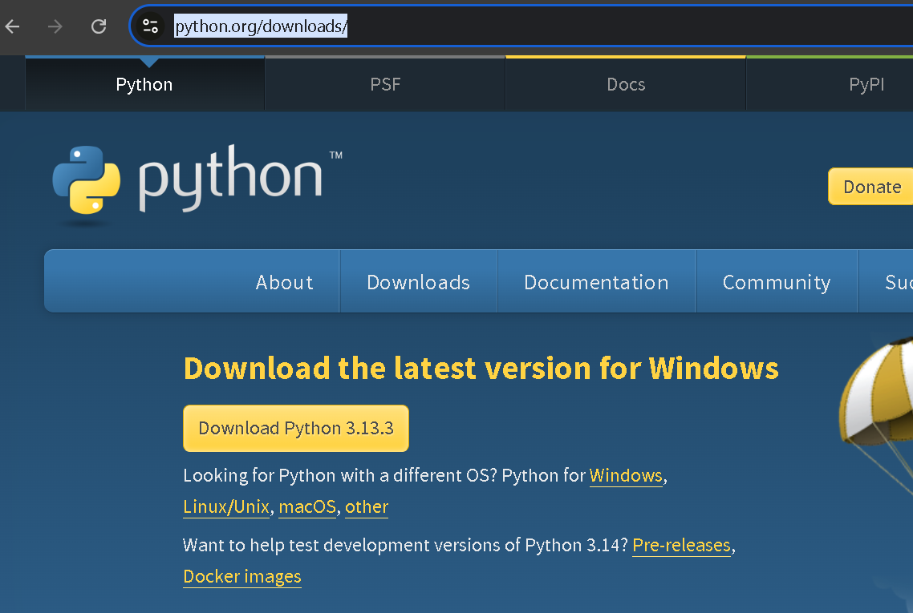
Setting Up the Python Environment
1
Download Python
Trainer: Fawad Bahadur Marwat

Slide 8
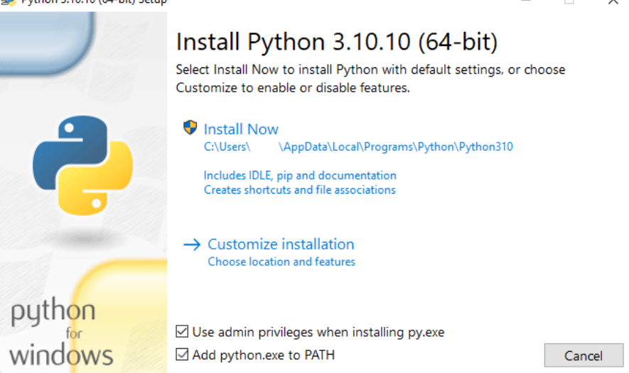
Setting Up the Python Environment
1
2
Download Python
Install Python
2
1
Trainer: Fawad Bahadur Marwat

Slide 9
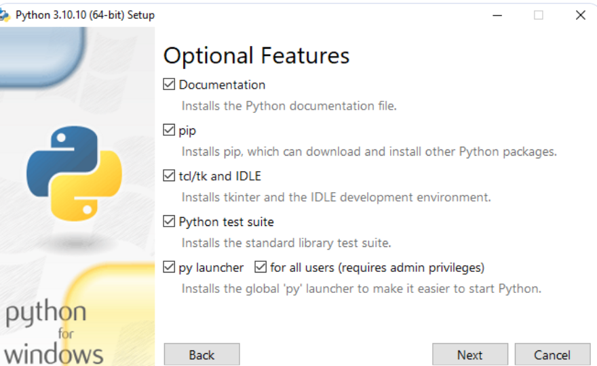
Setting Up the Python Environment
1
2
Download Python
Install Python
Trainer: Fawad Bahadur Marwat

Slide 10
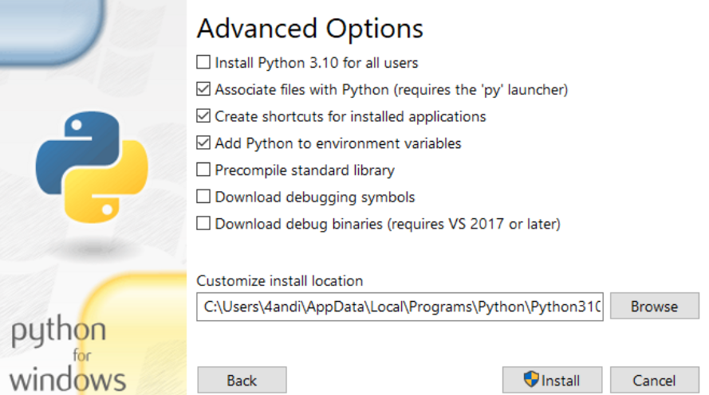
Setting Up the Python Environment
1
2
Download Python
Install Python
Trainer: Fawad Bahadur Marwat

Slide 11
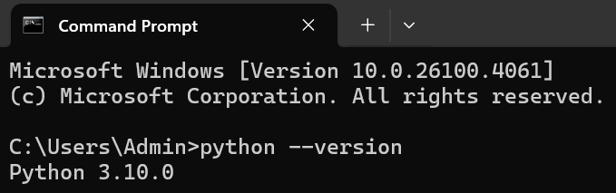
Setting Up the Python Environment
1
2
3
Download Python
Install Python
Verify the Python Installation
Go to Start
Enter cmd in the search bar
Click Command Prompt
Enter python --version.
Trainer: Fawad Bahadur Marwat

Slide 12




Install Python via Anaconda
Why Anaconda?
Includes Python, Jupyter Notebook, and key libraries.
Simplifies setup for immediate coding.
Download Anaconda
Installation Process
Visit the official Anaconda website.
Select the installer for your OS.
Run the setup file.
Follow default installation options (Windows/Mac/Linux).
Trainer: Fawad Bahadur Marwat

Slide 13

Set Up Jupyter Notebook
1
2
Open Anaconda Navigator
Start Jupyter Notebook
Launch from your system after installation.
In Navigator, click the Jupyter Notebook icon.
3
4
Create a New Notebook
Start Coding
Opens in your web browser.
Click New > Python 3 in top-right.
Write Python code in notebook cells.
Press Shift + Enter to execute.
Trainer: Fawad Bahadur Marwat

Slide 14

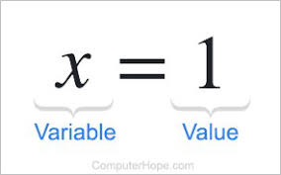

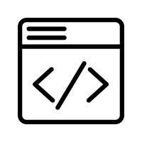
Variables in Python
What is a Variable?
A named container to store data in memory.
Holds values that can be changed during program execution.
Key Rules
Names are case-sensitive (x ≠ X).
Can include letters, digits, _ (no spaces).
Cannot start with a digit.
Avoid Python keywords (if, for, etc.).
Example
Syntax
age = 25
name = "Alice"
variable_name = value
Trainer: Fawad Bahadur Marwat

Slide 15
Data Types
Dict
int
str
bool
list
tuple
float
Trainer: Fawad Bahadur Marwat

Slide 16
Integers in Python
What is a Integers?
Syntax
A whole number (positive, negative, or zero) without decimals.
Used for counting, indexing, and mathematical operations.
variable_name = integer_value
Key Properties
Example
Immutable: Cannot be changed after creation
(a new object is created on modification).
Unlimited Size: Python handles large numbers seamlessly.
age = 30
temperature = -10
count = 0
Trainer: Fawad Bahadur Marwat

Slide 17
Floating-Point Numbers (Floats) in Python
What is a Floats?
Syntax
Represents real numbers (with decimal points or scientific notation).
Used for measurements, scientific calculations, and fractional values.
variable_name = float_value
Key Properties
Example
Precision: Limited by hardware (64-bit double-precision).
Immutable: Like integers, floats are immutable objects.
pi = 3.14159
temperature = -12.5
scientific_notation = 2.5e3 # 2500.0
Trainer: Fawad Bahadur Marwat

Slide 18
Strings in Python
What is a String?
Syntax
A sequence of characters enclosed in quotes (' ' or " ").
Used to represent text data in Python.
string_name = "text" # or 'text'
Key Properties
Example
Immutable: Cannot be changed after creation.
Indexed: Access characters using indices (starts at 0).
Iterable: Can loop through characters.
name = "Alice"
greeting = 'Hello, World!'
multiline = """This is a
multi-line string"""
Trainer: Fawad Bahadur Marwat

Slide 19

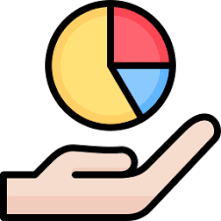
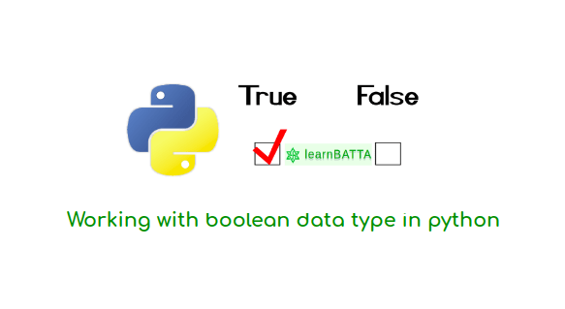
Boolean (bool)
Definition
Represent True or False values.
Example
is_logged_in = True
if is_logged_in:
print("User is logged in")
# Output: User is logged in
Key Uses:
Control flow in if and while statements.
Result of logical operations (e.g., 5 > 3 → True).
Represent states (e.g., on/off, open/closed).
Conversions:
bool(0) → False,
bool(1) → True.
Trainer: Fawad Bahadur Marwat

Slide 20
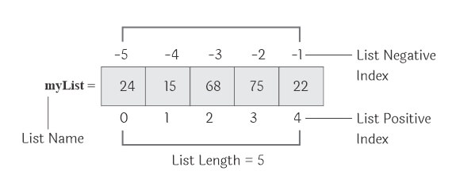
List
Definition: Ordered, mutable collections of items.
Key Features:
Can store mixed data types (e.g., integers, strings, lists).
Indexed from 0.
Supports operations: .append(), .remove(), .sort().
Use Cases:
Store sequences (e.g., names, numbers, objects).
Example
fruits = ["apple", "banana", "cherry"]
fruits.append("orange")
print(fruits)
# Output: ['apple', 'banana', 'cherry', 'orange']
Trainer: Fawad Bahadur Marwat

Slide 21
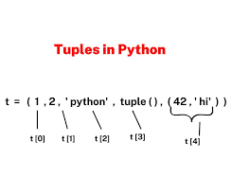
Tuple
Definition: Ordered, immutable collections of items.
Key Features:
Values cannot be changed after creation.
Indexed from 0, like lists.
Can store mixed data types (e.g., integers, strings, tuples).
Use Cases:
Fixed data sets (e.g., coordinates, color values).
Unpacking: x, y = (10, 20).
Example
coordinates = (34.0522, -118.2437)
print(coordinates[0]) # Output: 34.0522
Trainer: Fawad Bahadur Marwat

Slide 22
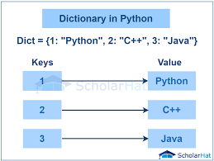
Dictionary
Definition: Stores data in key-value pairs for fast lookups.
Keys: Unique, immutable (e.g., strings, numbers, tuples).
Values: Any data type, mutable.
Use Cases: Structured data (e.g., user profiles, settings, JSON).
Example
student = {"name": "Alice", "age": 22}
print(student["name"]) # Output: Alice
Key Operations
Add: dict['key'] = value
Remove: del dict['key']
Advantage: Fast key-based access via hashing.
Trainer: Fawad Bahadur Marwat

Slide 23

Set
Definition: Stores unique, unordered elements..
Keys: Unique, immutable (e.g., strings, numbers, tuples).
Values: Elements must be immutable (e.g., strings, numbers, tuples).
Use Cases: Membership testing, removing duplicates, mathematical set operations (union, intersection, difference).
Example
numbers = {1, 2, 3, 3, 4}
print(numbers)
# Output: {1, 2, 3, 4} (order may vary)
print(2 in numbers)
# Output: True
Key Operations
Add: set.add(element)
Remove: set.remove(element)
Advantage: Fast membership testing via hashing; automatic duplicate removal.
Trainer: Fawad Bahadur Marwat

Slide 24
Comparison of Mutability and Use Case
Data Type | Example | Mutable | Use Case
Int | x = 5 | - | Whole numbers
Float | y = 3.24 | - | Decimals
Str | s = ‘text’ | ❌ | Text
Bool | Flag = True | - | True/False
List | [1,2,3] | ✅ | Modifiable collection
Tuple | (1,2) | ❌ | Fixed Collection
Dict | {“key” : “value” | ✅ | Key-Value Pairs
Set | {1,2,3} | ✅ | Unique elements
Trainer: Fawad Bahadur Marwat

Slide 25
Huawei HCCDA-AI certification
Trainer: Fawad Bahadur Marwat
3

Slide 26

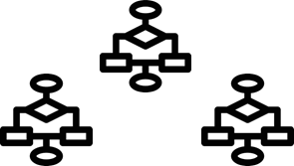
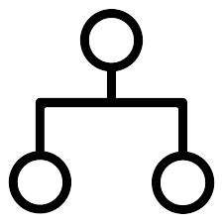
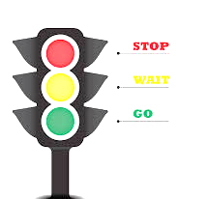
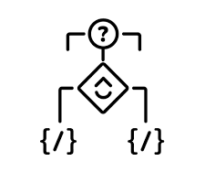
Conditional Statements
Definition
Conditional statements enable programs to execute different actions based on whether a condition evaluates to True or False.
Condition
A logical expression resulting in a boolean (True or False).
Purpose
Controls program flow by enabling decision-making.
Real-Life Analogy
Traffic light:
Green → Cars go.
Red → Cars stop.
Why Use Them?
Execute actions when a condition is True.
Skip actions when a condition is False.
Trainer: Fawad Bahadur Marwat

Slide 27
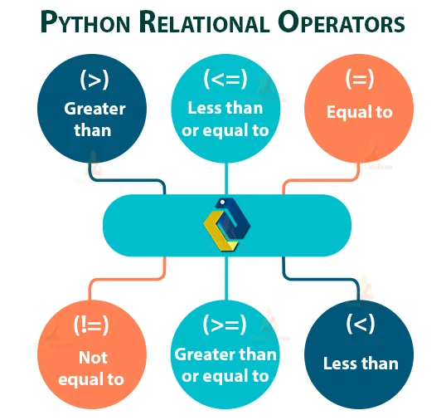
Conditions in Python
Definition
Expressions evaluating to True or False
Comparison Operators
Usage
Control flow in if, if-else, if-elif-else statements
Example
How It Works: x > 5 evaluates to True, triggering the print statement.
x = 5
if x > 5:
print("x is greater than 5")
Trainer: Fawad Bahadur Marwat

Slide 28
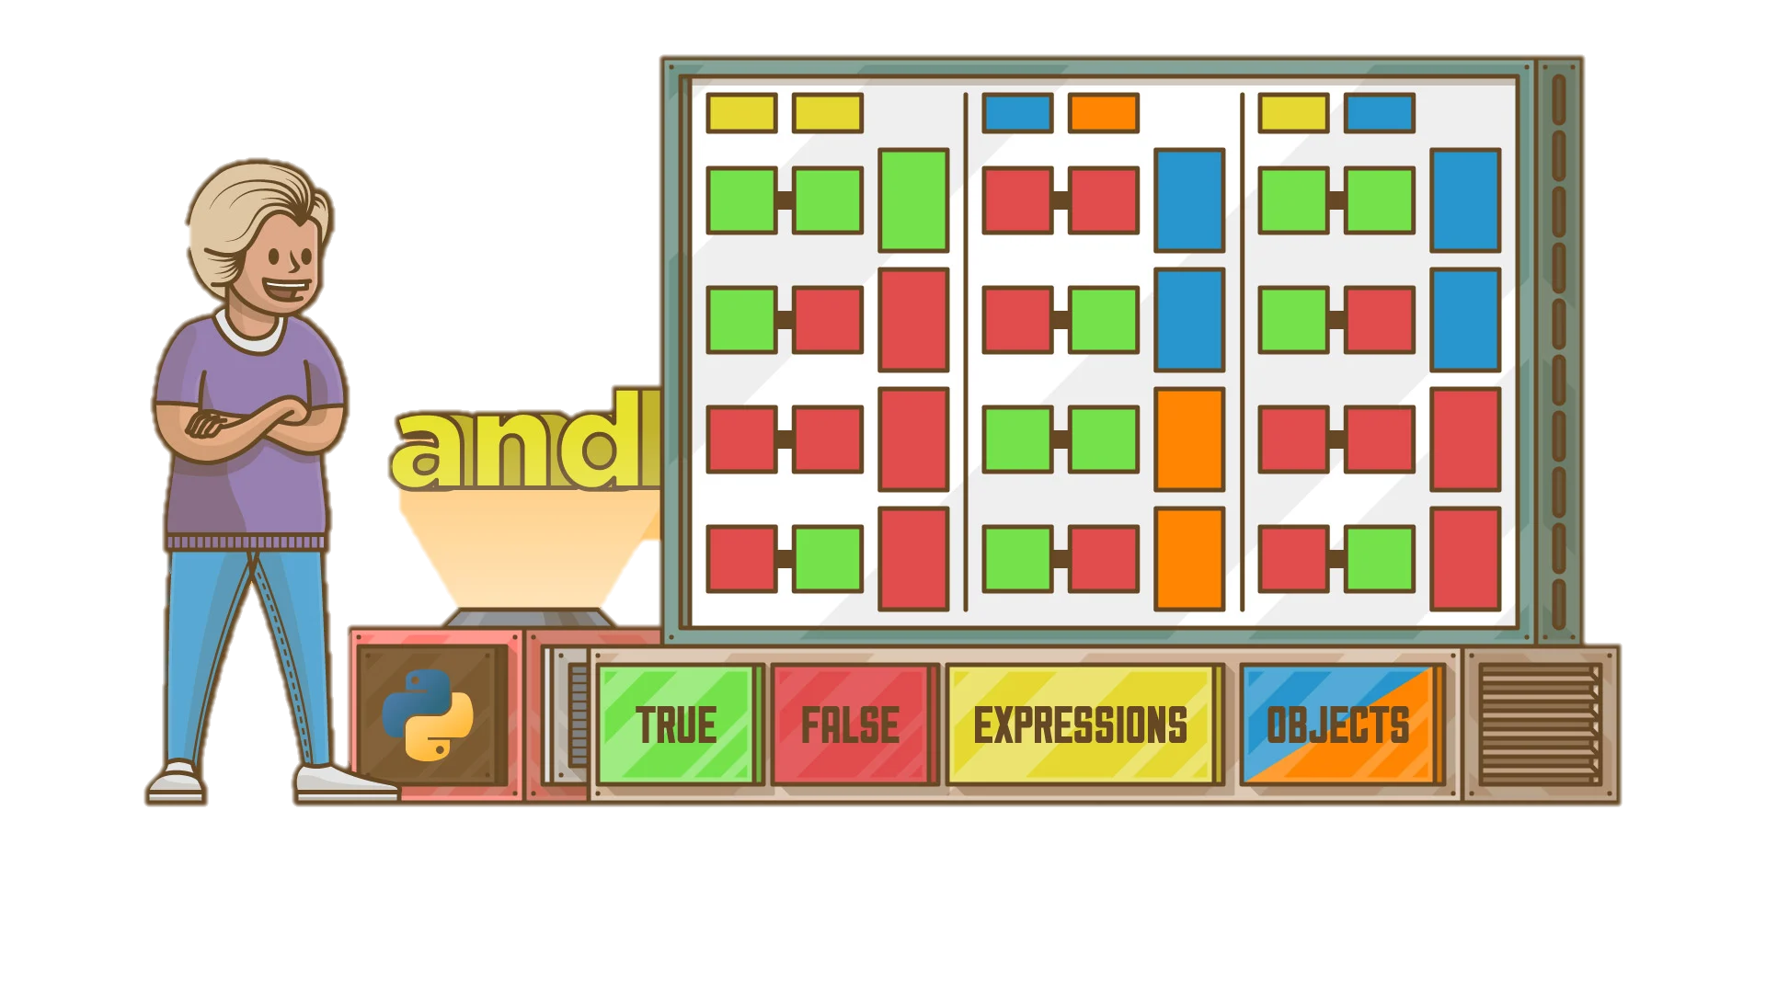
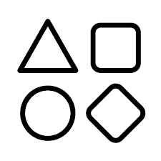
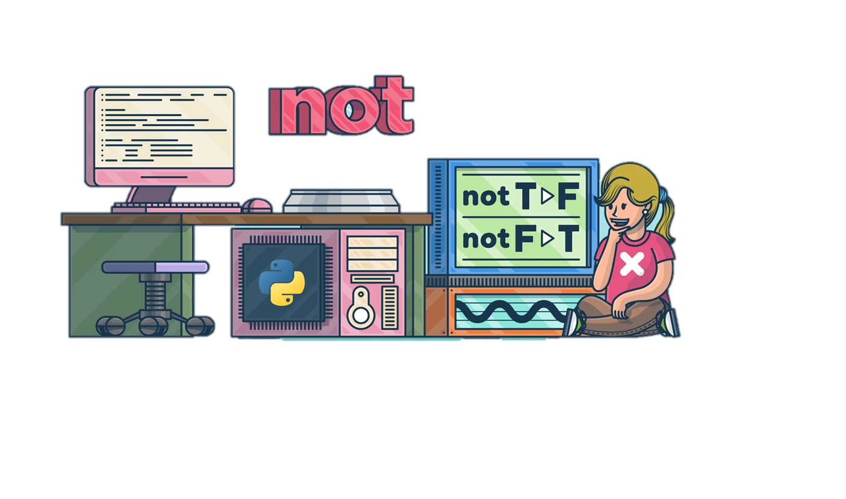
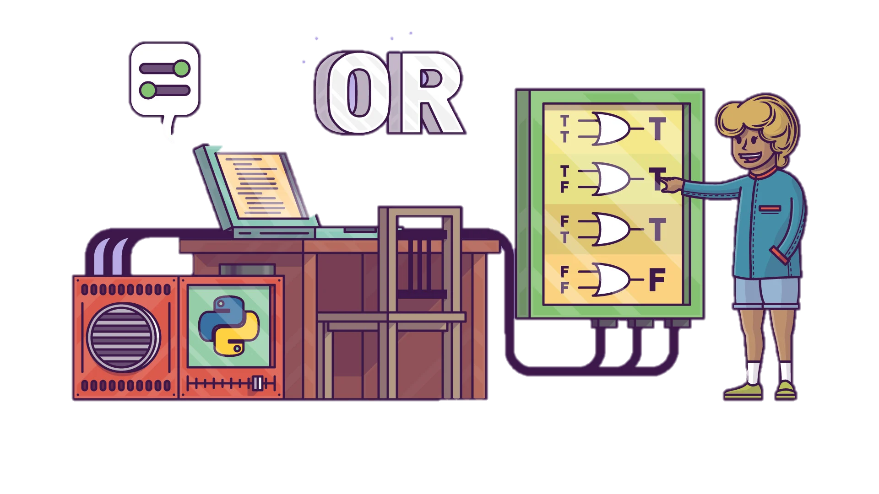
Logical Operators in Python
Purpose
Combine multiple conditions to return True or False
Types
and: True if both conditions are True
or: True if at least one condition is True
not: Reverses a condition
(True → False, False → True)
Example
and: Both age > 18 and age < 30 must be True to print.
or: Either grade == 'A' or grade == 'B' being True triggers the print.
# and operator
age = 20
if age > 18 and age < 30:
print("You're a young adult")
# or operator
grade = 'B'
if grade == 'A' or grade == 'B':
print("You passed")
Trainer: Fawad Bahadur Marwat

Slide 29
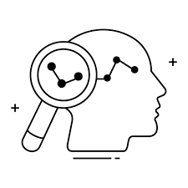
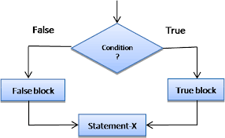
If Statements in Python
Purpose
Example
Execute a code block only if a condition is True
num = 10
if num > 5:
print("The number is greater than 5")
Syntax
if keyword, followed by a condition, then a colon :
num > 5 evaluates to True, so the message is printed.
If num <= 5, the print statement is skipped.
Behavior
True condition: Code block executes
False condition: Code block is skipped
Trainer: Fawad Bahadur Marwat

Slide 30
If-else Statements in Python
Purpose
Example
Execute one code block if a condition is True,
otherwise execute a different code block.
num = 10
if num > 5:
print("The number is greater than 5")
else:
print(“The number is not greater than 5”)
Syntax
If a condition is True, then execute a code block; else, execute a different code block.
Behavior
True condition: Code block 1 executes
False condition: Code block 2 executes
Trainer: Fawad Bahadur Marwat

Slide 31
If-Elif-Else Statements in Python
Purpose
Example
Evaluate multiple conditions sequentially
Syntax
score = 75
if score >= 90:
print("Grade: A")
elif score >= 80:
print("Grade: B")
elif score >= 70:
print("Grade: C")
else:
print("Grade: D")
if: Checks the first condition
elif: Checks additional conditions if previous ones are False
else: Runs if no conditions are True (optional fallback)
Behavior
Executes the first True condition’s block or the else block if none are True
Trainer: Fawad Bahadur Marwat

Slide 32
Huawei HCCDA-AI certification
Trainer: Fawad Bahadur Marwat
4

Slide 33

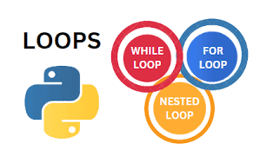
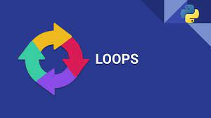

Introduction to Loops in Python
What Are Loops?
Programming structures that repeat instructions until a condition is met.
Enable iteration over data structures or repetitive task automation.
Why Use Loops?
Reduce code redundancy
Automate repetitive tasks
Improve code efficiency and readability
Types of Loops
while Loop: Repeats while a condition is `True`
for Loop: Iterates over a sequence (e.g., lists, tuples, strings)
Trainer: Fawad Bahadur Marwat

Slide 34

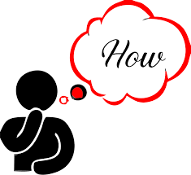
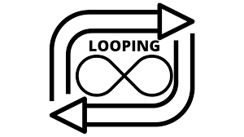
Iterating with Python Loops
What Is Iteration?
Accessing each item in a collection (e.g., list, tuple, string) one by one.
How Loops Work
Iterate over Python data structures: lists, dictionaries, sets, strings.
Enable sequential processing of items in an iterable.
Key Points
Loops provide sequential access to elements.
Use loops to read or modify items in sequences (e.g., lists, strings).
Trainer: Fawad Bahadur Marwat

Slide 35
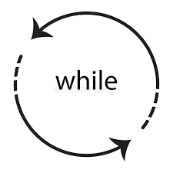
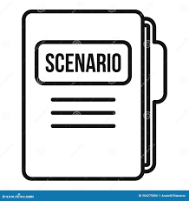
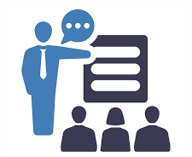
The while Loop in Python
How It Works
Example
Executes a code block as long as a condition is True.
Stops when the condition becomes False.
count = 0
while count < 3:
print("Counting:", count)
count += 1
Useful Scenarios
Explanation
Checks if count < 3 (True initially).
Prints count and increments by 1.
Stops when count reaches 3 (False).
When the number of iterations is unknown (e.g., reading a file until its end).
Trainer: Fawad Bahadur Marwat

Slide 36
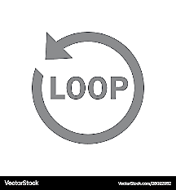
The for Loop in Python
How It Works
Example
Iterates over each item in an iterable
(e.g., list, string, dictionary) until all items are processed.
colors = ["red", "green", "blue"]
for color in colors:
print("Color:", color)
Useful Scenarios
Explanation
List: Loops through colors, printing each item.
When the number of iterations is known or iterating over a collection (e.g., lists, strings).
Trainer: Fawad Bahadur Marwat

Slide 37
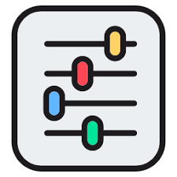
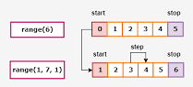
The range() Function in Python
Purpose
Example
Generates a sequence of numbers for iterating a specific number of times.
for i in range(1, 6):
print(i)
for i in range(5, 0, -1):
print(i)
Parameters
Start: starting number (default: 0)
Stop: end number (non-inclusive)
Step: increment/decrement (default: 1)
Trainer: Fawad Bahadur Marwat

Slide 38

The break Statement in Python
Purpose
Example
Exits a loop prematurely when a specific condition is met.
for number in range(10):
if number == 5:
break
print(number)
When to Use
Explanation
Loops through numbers 0 to 9.
When number == 5, break stops the loop.
Output: Prints 0, 1, 2, 3, 4.
To stop a loop immediately (e.g., when finding a target element in a list).
Trainer: Fawad Bahadur Marwat

Slide 39
The continue Statement in Python
Purpose
Example
Skips the current iteration and proceeds to the next one without exiting the loop.
for i in range(5):
if i == 2:
continue
print(i)
When to Use
Explanation
Loops through numbers 0 to 4.
When i == 2, continue skips the print statement.
To bypass specific iterations (e.g., skipping unwanted values in a dataset).
Trainer: Fawad Bahadur Marwat

Slide 40
The Pass Statement in Python
Purpose
Example
A null operation; acts as a placeholder when no action is needed.
Used where code is syntactically required but not yet implemented.
for i in range(5):
if i < 3:
pass
print(i)
When to Use
Explanation
Loops through numbers 0 to 4.
When i < 3, pass does nothing, and the loop continues.
Output: Prints 0, 1, 2, 3, 4.
As a temporary placeholder (e.g., in empty loops, functions, or try blocks).

Slide 41
Huawei HCCDA-AI certification
Trainer: Fawad Bahadur Marwat
5

Slide 42
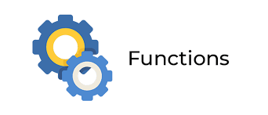
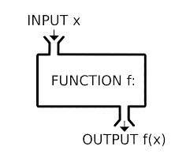
Introduction to Function in Python
Definition
Named, reusable code blocks for specific tasks.
Example
Purpose
def greet(name):
print(f"Hello, {name}!")
greet("Alice") # Output: Hello, Alice!
Organize code into manageable parts.
Promote reusability, reduce redundancy.
Enable multiple calls throughout a program.
Explanation
greet function takes name parameter and prints a greeting.
Syntax
Use def keyword, function name, and parameters in ().

Slide 43
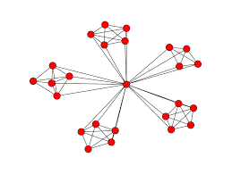

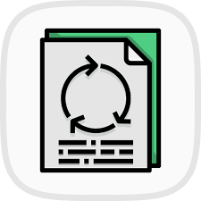
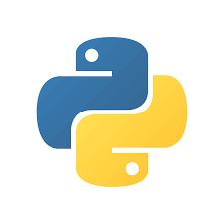
Functions: Modularity & Reusability
Modularity
Encapsulate functionality for organized, navigable code.
Develop, test, and debug functions independently.
Enhances software quality and maintainability.
Code Reusability
Reuse functions across programs or sections.
Eliminates redundant code.
Keeps codebase clean and maintainable.
Trainer: Fawad Bahadur Marwat

Slide 44
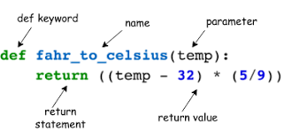
Function Definition in Python
Syntax
Use def keyword, function name, and () for parameters.
Parameters (optional) accept inputs for the function.
Example
def add(a, b):
return a + b
print(add(3, 4)) # Output: 7
Purpose
Define reusable code to perform specific tasks.
Return results using return (optional).
Explanation
add function takes parameters a and b.
Returns their sum using return.
Trainer: Fawad Bahadur Marwat

Slide 45

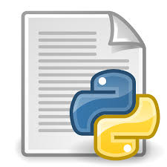

Executing Functions in Python
Function Execution
Example
Runs when called, executing the function’s code body.
def greet(name):
print(f"Hello, {name}!")
greet("Alice") # Output: Hello, Alice!
greet("Bob") # Output: Hello, Bob!
greet("Charlie") # Output: Hello, Charlie!
Calling Syntax
Use function name followed by ().
Include arguments in () if required.
Explanation
greet function is called multiple
times with different arguments.
Multiple Calls
Reuse functions by calling them multiple times.
Trainer: Fawad Bahadur Marwat

Slide 46



Function Arguments in Python
Definition
Values (arguments) passed to a function for processing.
Used as inputs for calculations or manipulations.
Example
def multiply(a, b):
return a * b
result = multiply(4, 5)
print(result) # Output: 20
Importance
Enable generic, flexible functions.
Avoid hardcoding, work with varied data.
Benefits
Dynamic functionality with different inputs.
Improves code readability and maintainability.
Trainer: Fawad Bahadur Marwat

Slide 47

Positional Arguments in Python
Definition
Example
Arguments passed in the order of function parameters.
First argument matches first parameter, and so on.
def divide(numerator, denominator):
if denominator == 0:
return "Error: Cannot divide by zero."
return numerator / denominator
result1 = divide(10, 2) # Output: 5.0
result2 = divide(2, 10) # Output: 0.2
print(result1)
print(result2)
Key Point
Order matters; incorrect order causes logical errors.
Explanation
Correct: divide(10, 2) → 10 / 2 = 5.0.
Incorrect order: divide(2, 10) → 2 / 10 = 0.2.
Trainer: Fawad Bahadur Marwat

Slide 48

Keyword Arguments in Python
Definition
Specify parameter names and values when calling a function.
Allows arguments to be passed in any order.
Example
def profile(name, age, city):
return f"{name} is {age} years old and lives in {city}."
info = profile(age=30, name="Alice", city="New York")
print(info) # Output: Alice is 30 years old and lives in New York.
Benefits
Clarity: Clearly indicates what each argument represents.
Flexibility: Order-independent, ideal for optional parameters.
Explanation
Arguments passed using parameter names, ignoring order.
Trainer: Fawad Bahadur Marwat

Slide 49
*args in Python
Definition
Example
Allows a function to accept any number of positional arguments.
Arguments are collected as a tuple.
def concatenate_strings(*args):
return " ".join(args)
result = concatenate_strings("Hello", "world", "from", "Python!")
print(result) # Output: Hello world from Python!
Benefits
Ideal when the number of arguments is unknown.
Explanation
*args gathers all arguments into a tuple.
join() combines them into a single string.
Trainer: Fawad Bahadur Marwat

Slide 50

Global vs. Local Variables in Python
Global Variables
Local Variables
Defined outside functions.
Accessible anywhere in the code.
Defined inside a function.
Accessible only within that function’s scope.
Example
global_var = 10 # Global variable
def function():
local_var = 5 # Local variable
print(global_var) # Output: 10
function()
# print(local_var) # Error: local_var is not accessible
Explanation
global_var is accessible everywhere.
local_var is limited to the function; accessing it outside raises an error.
Trainer: Fawad Bahadur Marwat

